Slide 1






Examining the effects of celebrity endorsements on brand equity and self-brand connection
Abhishek Dwivedi
Charles Sturt University, Albury-Wodonga, NSW, Australia.
Lester Johnson
Swinburne University of Technology,
Hawthorn, Australia.
Bob McDonald
Texas Tech University, Lubbock, Texas, USA.
4th International Consumer Brand Relationships Conference, Porto Business School, Porto, Portugal, 21-23 May, 2015

Slide 2
Celebrity endorsements and brand equity
Celebrity endorsements represent approximately 15% of advertisements
Advertisers imbue the endorsed brands with desirable associations
Endorsements effects largely explained by endorser credibility
Research into the effects of celebrity endorsers on brand equity remains limited
First objective: empirically assess the impact of celebrity endorsements on consumer-based brand equity

Slide 3
Celebrity endorsements and self-concept
Celebrities are an embodiment of personality- and lifestyle-related meanings.
Consumers use the symbolic meanings to craft an individual sense of self.
Empirical investigations into self-concept implications of endorsements remains limited
Second objective: We investigate the effect of endorser credibility on consumer self-brand connection (SBC).

Slide 4
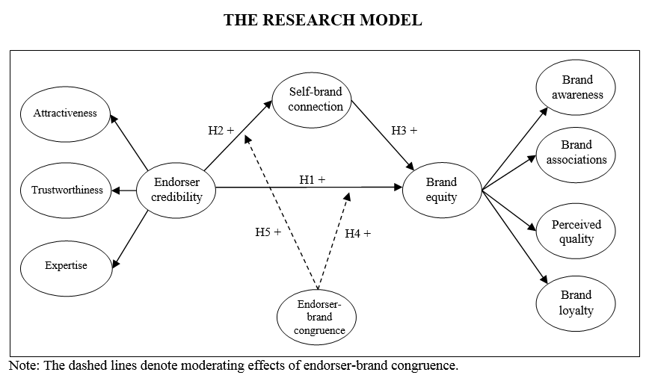
Our Model

Slide 5
Conceptual background
Associative-network memory theory (Keller, 1993)
  Explains the effect of endorser credibility on brand equity.
Theory of meaning movement (McCracken, 1989)
  Explains the effect of endorser credibility on SBC.
Match-up hypothesis (Kahle and Homer, 1985)
  Explains how endorser-brand congruence may modulate endorser credibility effects

Slide 6
Design: Stimulus
Based on a pilot test with 23 students
Free recall generated unique 73 celeb-brand combinations across 41 categories
Stimulus category chosen on the basis of high salience, endorsement activity across brands, gender neutral.
Sports drink category chosen
Endorser-brand pairings that were operating in the market at the time :
LeBron James – Powerade
Derrick Rose – Powerade
Kevin Durant – Gatorade
Dwayne Wade – Gatorade

Slide 7
Survey
A cross-sectional survey of 382 university students
All constructs adapted from previous operationalizations
Brand equity operationalized as a 2nd-order construct: brand awareness, brand associations, perceived quality and brand loyalty.
Endorser credibility operationalized as a 2nd-order construct: attractiveness, expertise and trustworthiness.
We also collected data on multiple covariates: endorser familiarity, endorser attitude and consumers’ product knowledge.

Slide 8
Results
SEM used for data analysis
Psychometric properties acceptable:
  Common method bias not a threat (Harman test, ‘marker’ variable test)
  Final measurement model yields acceptable fit: CFI = 0.90; RMSEA = 0.064.
  Standardized first-order loadings > 0.65; Higher-order loadings acceptable
  Composite reliabilities > 0.70; AVEs > 0.50
Structural model
  Acceptable fit: CFI = 0.91; RMSEA = 0.060.
  All direct paths are significant at p < 0.05.
  Moderation is also supported (interaction terms significant at p < 0.05)
  Effects of endorser credibility on brand equity and SBC become stronger as congruence increases.

Slide 9
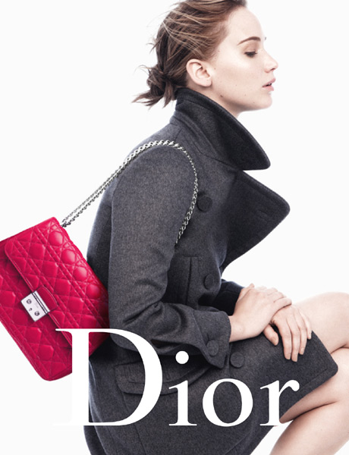
Managerial Implications
Credible celebrity endorsers possess the ability to impact endorsed brand equity
Practitioners should recruit and select celebrity endorsers that possess the desired meanings and associations that are needed in the endorsed brand
Example: Jennifer Lawrence & Dior; associations of ‘young’, ‘talented’ and ‘successful’ can be transferred to Dior.
Source: The Telegraph, UK (2013) http://fashion.telegraph.co.uk/article/TMG10289949/Jennifer-Lawrence-goes-bare-faced-for-Miss-Dior.html

Slide 10
Managerial Implications
Celebrity endorsers can be strategically used to develop a stronger level of engagement with consumers given their potential to address SBC.
SBC may now be considered as a key performance indicator of celebrity endorser effectiveness.
Facilitating the development of SBC, especially among a younger (i.e., Gen Y) consumer group, brands are likely to experience a favorable impact on brand equity.
Using SBC as a measure of celebrity’s consumer engagement proficiency might be more effective method for advertisers to use when hiring celebrities rather than relying on celebrity rankings.
We suggest that SBC may provide a rich, brand-specific measure to better predict success of the endorsement.

Slide 11
Thank you for your time!
Comments, feedback and suggestions? ☺

